Slide 1
Object Oriented Programming -I
Bhavisha Patel

Slide 2
Static keyword
The static keyword in Java is used for memory management mainly.
We can apply static keyword with variables, methods, blocks and nested classes.
The static can be:
Variable
Method
Block
Nested class

Slide 3
1) Static variable
If you declare any variable as static, it is known as a static variable.
The static variable can be used to refer to the common property of all objects (which is not unique for each object), for example, the company name of employees, college name of students, etc.
The static variable gets memory only once in the class area at the time of class loading.
Java static property is shared to all objects.

Slide 4
Example of static variable
class Student{
int rollno;//instance variable
String name;
static String college ="ITS";
Student(int r, String n){
rollno = r;
name = n;
}
void display (){System.out.println(rollno+" "+name+" "+college);}
}
public class TestStaticVariable1{
public static void main(String args[]){
Student s1 = new Student(111,"Karan");
Student s2 = new Student(222,"Aryan");
//we can change the college of all objects by the single line of code
//Student.college="BBDIT";
s1.display();
s2.display();
}
}

Slide 5
Output:
111 Karan ITS
222 Aryan ITS

Slide 6
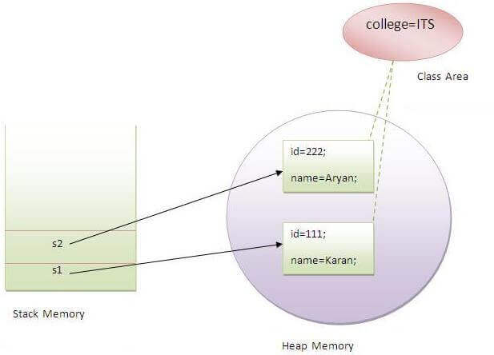

Slide 7
2) Static method
If you apply static keyword with any method, it is known as static method.
A static method belongs to the class rather than the object of a class.
A static method can be invoked without the need for creating an instance of a class.
A static method can access static data member and can change the value of it.

Slide 8
Example of static method
class Student{
int rollno;
String name;
static String college = "ITS";
static void change(){
college = "BBDIT";
}
Student(int r, String n){
rollno = r;
name = n;
}
void display(){System.out.println(rollno+" "+name+" "+college);}
}
public class TestStaticMethod{
public static void main(String args[]){
Student.change();//calling change method
Student s1 = new Student(111,"Karan");
Student s2 = new Student(222,"Aryan");
Student s3 = new Student(333,"Sonoo");
s1.display();
s2.display();
s3.display();
}
}

Slide 9
Output:
111 Karan BBDIT
222 Aryan BBDIT
333 Sonoo BBDIT

Slide 10
Another example of a static method
Output: 125
class Calculate{
static int cube(int x){
return x*x*x;
}
public static void main(String args[]){
int result=Calculate.cube(5);
System.out.println(result);
}
}

Slide 11
Restrictions for the static method
There are two main restrictions for the static method. They are:
The static method can not use non static data member or call non-static method directly.
this and super cannot be used in static context

Slide 12
3) Static block
Is used to initialize the static data member.
It is executed before the main method at the time of classloading.
Example of static block
class A2{
static{System.out.println("static block is invoked");}
public static void main(String args[]){
System.out.println("Hello main");
}
}

Slide 13
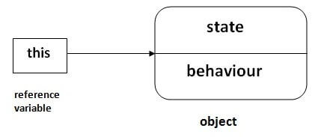
this keyword
In Java, this is a reference variable that refers to the current object.

Slide 14
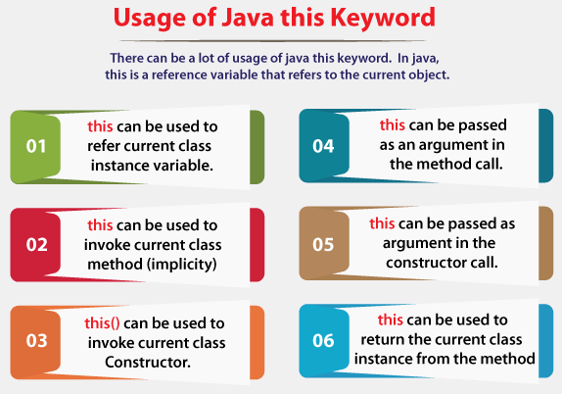
Usage of Java this keyword

Slide 15
1) this: to refer current class instance variable
The this keyword can be used to refer current class instance variable.
If there is ambiguity between the instance variables and parameters, this keyword resolves the problem of ambiguity.
this keyword to distinguish local variable and instance variable.

Slide 16
Example
class Student{
int rollno;
String name;
float fee;
Student(int rollno,String name,float fee){
this.rollno=rollno;
this.name=name;
this.fee=fee;
}
void display(){System.out.println(rollno+" "+name+" "+fee);}
}
class TestThis2{
public static void main(String args[]){
Student s1=new Student(111,"ankit",5000f);
Student s2=new Student(112,"sumit",6000f);
s1.display();
s2.display();
}}

Slide 17
Output:
111 ankit 5000.0
112 sumit 6000.0

Slide 18
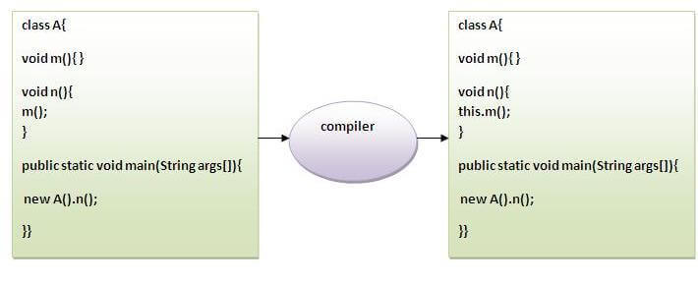
2) this: to invoke current class method

Slide 19
Example
class A{
void m(){System.out.println("hello m");}
void n(){
System.out.println("hello n");
//m();//same as this.m()
this.m();
}
}
class TestThis4{
public static void main(String args[]){
A a=new A();
a.n();
}}
Output:
hello n
hello m

Slide 20
3) this() : to invoke current class constructor
class A{
A(){System.out.println("hello a");}
A(int x){
this();
System.out.println(x);
}
}
class TestThis5{
public static void main(String args[]){
A a=new A(10);
}}
Output:
hello a
10

Slide 21
class A{
A(){
this(5);
System.out.println("hello a");
}
A(int x){
System.out.println(x);
}
}
class TestThis6{
public static void main(String args[]){
A a=new A();
}}

